Slide 1

ADULT
INCOME
PREDICTION
BY RAZAN JAAD
SDAIA - T5 BOOTCAMP

Slide 2

Problem
Predict if a person's salary is above 50 thousand or less
1

Slide 3
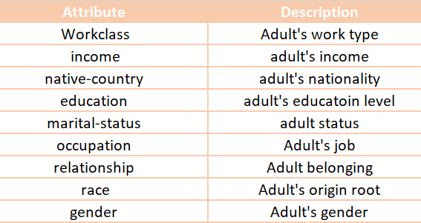
Data
The data contains more than 5000 rows and 14 attributes specific to the adult’s personal data, this data is processed by Preprocessing operations
2

Slide 4
Algorithms
01
EDA
Exploratory Data Analysis
02
Prepare
Preparing the data to train a model
03
Models
Training and making predictions using a 1 classification model (Logistic regression)
04
Evaluation
Comparison of different Models
3

Slide 5
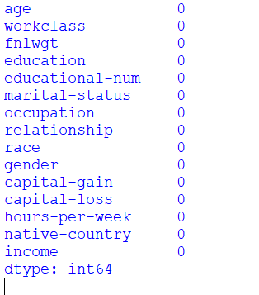
Data Pre-processing
Removing null values:
data = data.dropna()
After removing null value
4

Slide 6
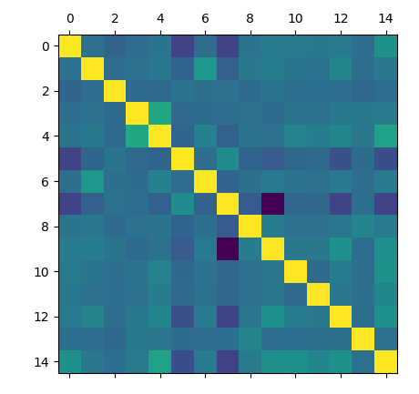

Data Visualization
First, the project makes all relationships between all columns using the code:
The result
5

Slide 7
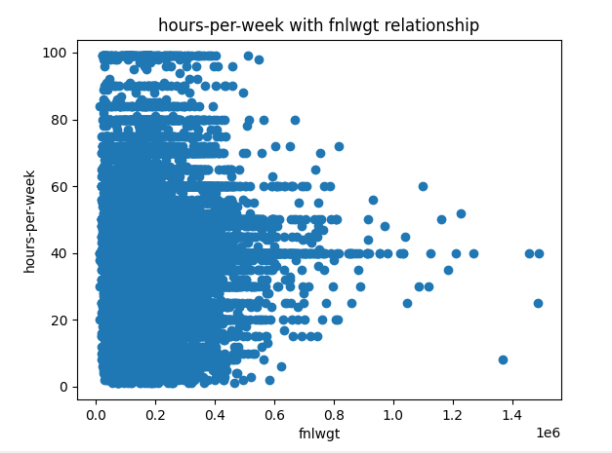
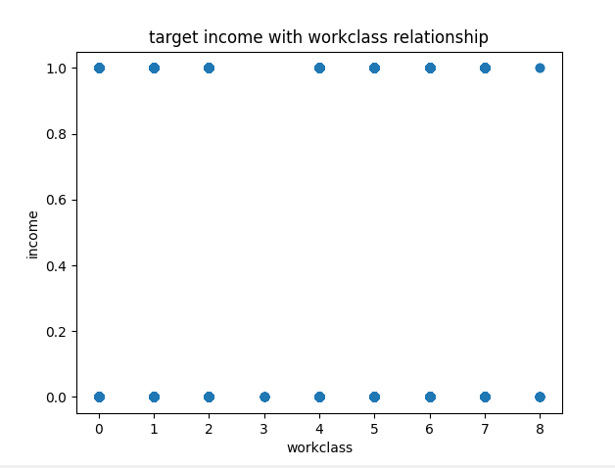
Data Visualization
Correlation between hours per week and fnlwgt
Correlation between workclass and income
6

Slide 8
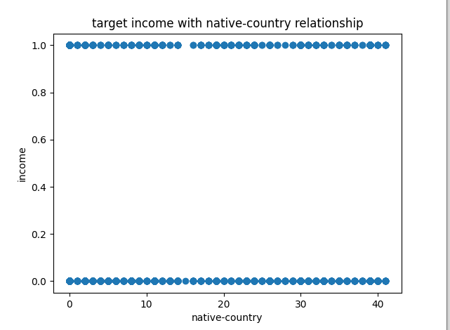
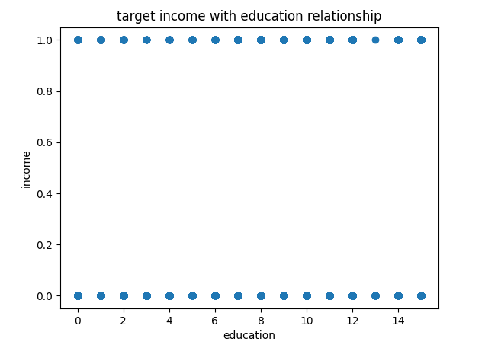
Data Visualization
Correlation between native-country and income
Correlation between education and income
7

Slide 9
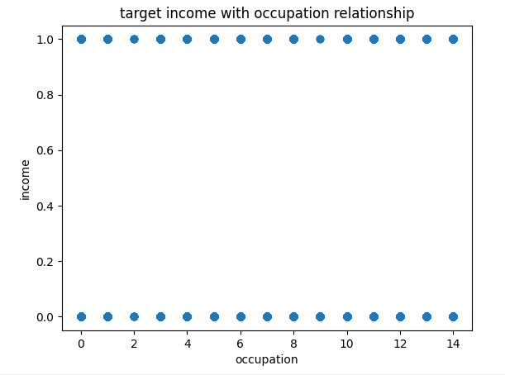
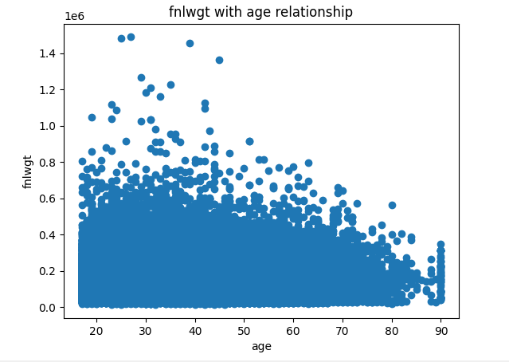
Data Visualization
Correlation between occupation and income
Correlation between age and fnlwgt
8

Slide 10
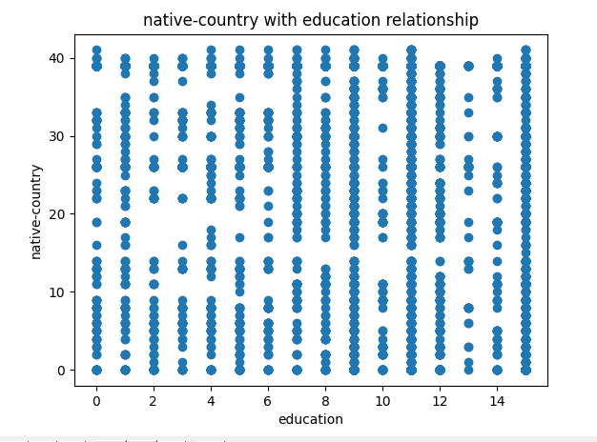
Data Visualization
Correlation between education and native country
9

Slide 11

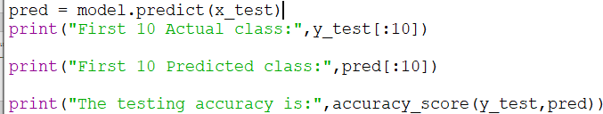
RESULTS
The accuracy of validation step is:
The accuracy of validation step is:
10

Slide 12

What is the FINAL RESULT?
The selected model get about 79% accuracy after making some preprocessing steps
and calculating the correlations between features. There is a very small correlations between features and this is the reason of the small accuracy.
11

Slide 13
Tools
Python
High-level Software language
Jupyter Notebook
Open-source web application
Sklearn
Software library for modelin
Pandas
Software library data manipulation.
Matplotlib
Software library for plotting
12

Slide 14
THANK YOU!

